Slide 2




















Slide 3








Slide 4











Slide 5






















below

Slide 6








Slide 7
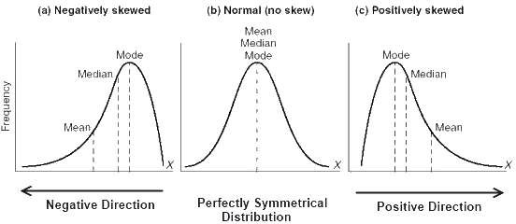

Slide 8




























Slide 9
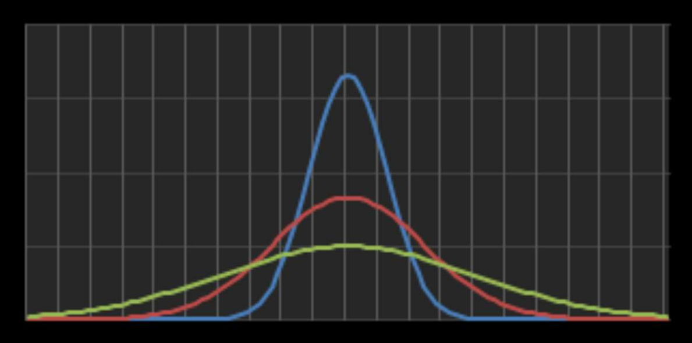

Slide 10








Slide 13
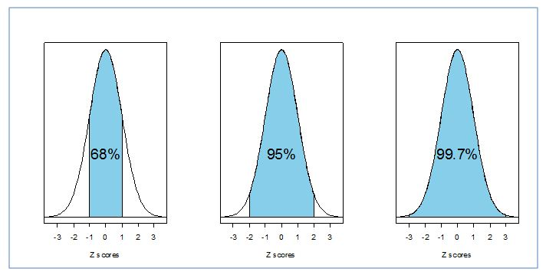
Empirical Rule

Slide 14
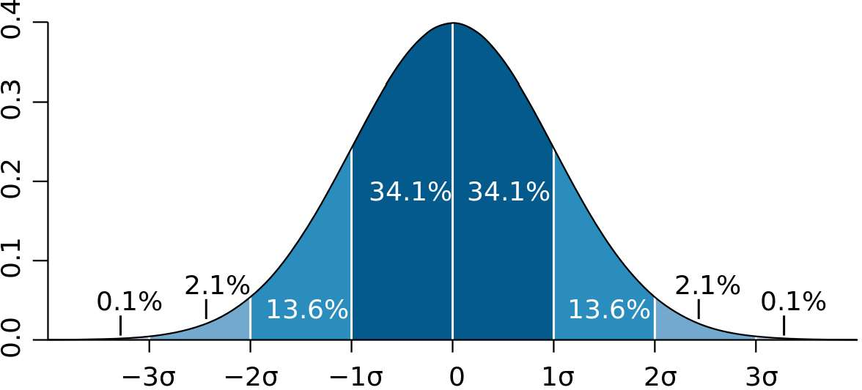

Slide 15

Measure | Qty
Price | 1 million
Sq. Ft. | 2,500
Neighborhood Rating | 79
# Bedrooms | 4

Slide 16
Measure | Qty
Price | 1 million
Sq. Ft. | 2,500
Neighborhood Rating | 79
# Bedrooms | 4
4
79
2500
1 m
0

Slide 17
Measure | Qty
Price | 1 million
Sq. Ft. | 2,500
Neighborhood Rating | 79
# Bedrooms | 4

Slide 18
Measure | Qty | Standardized (z-score)
Price | 1 million | .89
Sq. Ft. | 2,500 | .96
Neighborhood Rating | 79 | -.14
# Bedrooms | 4 | 1.32

Slide 19



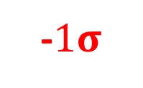
Measure | Qty | Standardized (z-score)
Price | 1 million | .89
Sq. Ft. | 2,500 | .96
Neighborhood Rating | 79 | -.14
# Bedrooms | 4 | 1.32
$$−2σ$$
-$1σ$
0
$$1σ$$
$$2σ$$

Slide 20
Measure | Qty | Standardized (z-score)
Price | 1 million | .89
Sq. Ft. | 2,500 | .96
Neighborhood Rating | 79 | -.14
# Bedrooms | 4 | 1.32
79
$$−2σ$$
-$1σ$
|
0
$$1σ$$
$$2σ$$
-.14

Slide 21
Measure | Qty | Standardized (z-score)
Price | 1 million | .89
Sq. Ft. | 2,500 | .96
Neighborhood Rating | 79 | -.14
# Bedrooms | 4 | 1.32
79
1 m
$$−2σ$$
-$1σ$
|
0
|
$$1σ$$
$$2σ$$
-.14
.89

Slide 22
Measure | Qty | Standardized (z-score)
Price | 1 million | .89
Sq. Ft. | 2,500 | .96
Neighborhood Rating | 79 | -.14
# Bedrooms | 4 | 1.32
79
1 m
2500
$$−2σ$$
-$1σ$
|
0
|
|
$$1σ$$
$$2σ$$
-.14
.89
.96

Slide 23
Measure | Qty | Standardized (z-score)
Price | 1 million | .89
Sq. Ft. | 2,500 | .96
Neighborhood Rating | 79 | -.14
# Bedrooms | 4 | 1.32
79
1 m
2500
4
$$−2σ$$
-$1σ$
|
0
|
|
|
$$1σ$$
$$2σ$$
-.14
.89
.96
1.32

Slide 24
Example

Slide 25
Standardize the Data
x - mean
z-score =
std

Slide 26
Standardize the Data
x - mean
z-score =
std
mean = 5’6
std = 2”

Slide 27
Standardize the Data
5’10 - mean
z-score =
std
mean = 5’6
std = 2”

Slide 28
Standardize the Data
5’10 – 5’6
z-score =
std
std = 2”

Slide 29
Standardize the Data
5’10 – 5’6
z-score =
2”

Slide 30
Standardize the Data
4”
z-score =
2”

Slide 31
Standardize the Data
4”
2 =
2”

Slide 32









Slide 34


Slide 35















Slide 36







Slide 37



Slide 38



Slide 39
Santa Clara County Schools
 | Black pct | Asian pct | Hispnic pct | Mixed pct | White pct | Am.Ind pct | Filipino pct | Pac. Is. pct | Grad Pct | UCCSU ReqPct | DpOut Pct
count | 31 | 31 | 31 | 31 | 31 | 31 | 31 | 31 | 11 | 11 | 11
mean | 1.64 | 27.22 | 33.54 | 6.02 | 26.20 | 0.32 | 3.58 | 0.50 | 90.46 | 58.49 | 5.03
std | 1.07 | 18.26 | 23.73 | 3.54 | 20.15 | 0.40 | 3.93 | 0.46 | 5.98 | 15.27 | 4.74
min | 0.00 | 0.60 | 4.20 | 0.90 | 1.60 | 0.00 | 0.20 | 0.00 | 75.70 | 28.40 | 1.10
25% | 0.95 | 14.15 | 13.75 | 3.75 | 6.35 | 0.10 | 1.05 | 0.20 | 89.05 | 52.80 | 2.45
50% | 1.50 | 25.90 | 28.30 | 5.20 | 23.20 | 0.20 | 2.30 | 0.40 | 90.00 | 54.80 | 3.40
75% | 2.35 | 34.40 | 48.95 | 8.30 | 39.35 | 0.45 | 4.25 | 0.60 | 95.15 | 65.00 | 5.10
max | 4.80 | 73.60 | 91.90 | 14.90 | 72.90 | 2.20 | 17.70 | 2.40 | 97.10 | 81.60 | 17.80

Slide 40
Santa Clara County Schools
 | Black pct | Asian pct | Hispnic pct | Mixed pct | White pct | Am.Ind pct | Filipino pct | Pac. Is. pct | Grad Pct | UCCSU ReqPct | DpOut Pct
count | 31 | 31 | 31 | 31 | 31 | 31 | 31 | 31 | 11 | 11 | 11
mean | 1.64 | 27.22 | 33.54 | 6.02 | 26.20 | 0.32 | 3.58 | 0.50 | 90.46 | 58.49 | 5.03
std | 1.07 | 18.26 | 23.73 | 3.54 | 20.15 | 0.40 | 3.93 | 0.46 | 5.98 | 15.27 | 4.74
min | 0.00 | 0.60 | 4.20 | 0.90 | 1.60 | 0.00 | 0.20 | 0.00 | 75.70 | 28.40 | 1.10
25% | 0.95 | 14.15 | 13.75 | 3.75 | 6.35 | 0.10 | 1.05 | 0.20 | 89.05 | 52.80 | 2.45
50% | 1.50 | 25.90 | 28.30 | 5.20 | 23.20 | 0.20 | 2.30 | 0.40 | 90.00 | 54.80 | 3.40
75% | 2.35 | 34.40 | 48.95 | 8.30 | 39.35 | 0.45 | 4.25 | 0.60 | 95.15 | 65.00 | 5.10
max | 4.80 | 73.60 | 91.90 | 14.90 | 72.90 | 2.20 | 17.70 | 2.40 | 97.10 | 81.60 | 17.80

Slide 41
Santa Clara County Schools
 | Black pct | Asian pct | Hispnic pct | Mixed pct | White pct | Am.Ind pct | Filipino pct | Pac. Is. pct | Grad Pct | UCCSU ReqPct | DpOut Pct
count | 31 | 31 | 31 | 31 | 31 | 31 | 31 | 31 | 11 | 11 | 11
mean | 1.64 | 27.22 | 33.54 | 6.02 | 26.20 | 0.32 | 3.58 | 0.50 | 90.46 | 58.49 | 5.03
std | 1.07 | 18.26 | 23.73 | 3.54 | 20.15 | 0.40 | 3.93 | 0.46 | 5.98 | 15.27 | 4.74
min | 0.00 | 0.60 | 4.20 | 0.90 | 1.60 | 0.00 | 0.20 | 0.00 | 75.70 | 28.40 | 1.10
25% | 0.95 | 14.15 | 13.75 | 3.75 | 6.35 | 0.10 | 1.05 | 0.20 | 89.05 | 52.80 | 2.45
50% | 1.50 | 25.90 | 28.30 | 5.20 | 23.20 | 0.20 | 2.30 | 0.40 | 90.00 | 54.80 | 3.40
75% | 2.35 | 34.40 | 48.95 | 8.30 | 39.35 | 0.45 | 4.25 | 0.60 | 95.15 | 65.00 | 5.10
max | 4.80 | 73.60 | 91.90 | 14.90 | 72.90 | 2.20 | 17.70 | 2.40 | 97.10 | 81.60 | 17.80

Slide 42
Santa Clara County Schools
 | Black pct | Asian pct | Hispnic pct | Mixed pct | White pct | Am.Ind pct | Filipino pct | Pac. Is. pct | Grad Pct | UCCSU ReqPct | DpOut Pct
count | 31 | 31 | 31 | 31 | 31 | 31 | 31 | 31 | 11 | 11 | 11
mean | 1.64 | 27.22 | 33.54 | 6.02 | 26.20 | 0.32 | 3.58 | 0.50 | 90.46 | 58.49 | 5.03
std | 1.07 | 18.26 | 23.73 | 3.54 | 20.15 | 0.40 | 3.93 | 0.46 | 5.98 | 15.27 | 4.74
min | 0.00 | 0.60 | 4.20 | 0.90 | 1.60 | 0.00 | 0.20 | 0.00 | 75.70 | 28.40 | 1.10
25% | 0.95 | 14.15 | 13.75 | 3.75 | 6.35 | 0.10 | 1.05 | 0.20 | 89.05 | 52.80 | 2.45
50% | 1.50 | 25.90 | 28.30 | 5.20 | 23.20 | 0.20 | 2.30 | 0.40 | 90.00 | 54.80 | 3.40
75% | 2.35 | 34.40 | 48.95 | 8.30 | 39.35 | 0.45 | 4.25 | 0.60 | 95.15 | 65.00 | 5.10
max | 4.80 | 73.60 | 91.90 | 14.90 | 72.90 | 2.20 | 17.70 | 2.40 | 97.10 | 81.60 | 17.80

Slide 43
Santa Clara County Schools
 | Black pct | Asian pct | Hispnic pct | Mixed pct | White pct | Am.Ind pct | Filipino pct | Pac. Is. pct | Grad Pct | UCCSU ReqPct | DpOut Pct
count | 31 | 31 | 31 | 31 | 31 | 31 | 31 | 31 | 11 | 11 | 11
mean | 1.64 | 27.22 | 33.54 | 6.02 | 26.20 | 0.32 | 3.58 | 0.50 | 90.46 | 58.49 | 5.03
std | 1.07 | 18.26 | 23.73 | 3.54 | 20.15 | 0.40 | 3.93 | 0.46 | 5.98 | 15.27 | 4.74
min | 0.00 | 0.60 | 4.20 | 0.90 | 1.60 | 0.00 | 0.20 | 0.00 | 75.70 | 28.40 | 1.10
25% | 0.95 | 14.15 | 13.75 | 3.75 | 6.35 | 0.10 | 1.05 | 0.20 | 89.05 | 52.80 | 2.45
50% | 1.50 | 25.90 | 28.30 | 5.20 | 23.20 | 0.20 | 2.30 | 0.40 | 90.00 | 54.80 | 3.40
75% | 2.35 | 34.40 | 48.95 | 8.30 | 39.35 | 0.45 | 4.25 | 0.60 | 95.15 | 65.00 | 5.10
max | 4.80 | 73.60 | 91.90 | 14.90 | 72.90 | 2.20 | 17.70 | 2.40 | 97.10 | 81.60 | 17.80

Slide 44
Santa Clara County Schools
 | Black pct | Asian pct | Hispnic pct | Mixed pct | White pct | Am.Ind pct | Filipino pct | Pac. Is. pct | Grad Pct | UCCSU ReqPct | DpOut Pct
count | 31 | 31 | 31 | 31 | 31 | 31 | 31 | 31 | 11 | 11 | 11
mean | 1.64 | 27.22 | 33.54 | 6.02 | 26.20 | 0.32 | 3.58 | 0.50 | 90.46 | 58.49 | 5.03
std | 1.07 | 18.26 | 23.73 | 3.54 | 20.15 | 0.40 | 3.93 | 0.46 | 5.98 | 15.27 | 4.74
min | 0.00 | 0.60 | 4.20 | 0.90 | 1.60 | 0.00 | 0.20 | 0.00 | 75.70 | 28.40 | 1.10
25% | 0.95 | 14.15 | 13.75 | 3.75 | 6.35 | 0.10 | 1.05 | 0.20 | 89.05 | 52.80 | 2.45
50% | 1.50 | 25.90 | 28.30 | 5.20 | 23.20 | 0.20 | 2.30 | 0.40 | 90.00 | 54.80 | 3.40
75% | 2.35 | 34.40 | 48.95 | 8.30 | 39.35 | 0.45 | 4.25 | 0.60 | 95.15 | 65.00 | 5.10
max | 4.80 | 73.60 | 91.90 | 14.90 | 72.90 | 2.20 | 17.70 | 2.40 | 97.10 | 81.60 | 17.80

Slide 45
Santa Clara County Schools
 | Black pct | Asian pct | Hispnic pct | Mixed pct | White pct | Am.Ind pct | Filipino pct | Pac. Is. pct | Grad Pct | UCCSU ReqPct | DpOut Pct
count | 31 | 31 | 31 | 31 | 31 | 31 | 31 | 31 | 11 | 11 | 11
mean | 1.64 | 27.22 | 33.54 | 6.02 | 26.20 | 0.32 | 3.58 | 0.50 | 90.46 | 58.49 | 5.03
std | 1.07 | 18.26 | 23.73 | 3.54 | 20.15 | 0.40 | 3.93 | 0.46 | 5.98 | 15.27 | 4.74
min | 0.00 | 0.60 | 4.20 | 0.90 | 1.60 | 0.00 | 0.20 | 0.00 | 75.70 | 28.40 | 1.10
25% | 0.95 | 14.15 | 13.75 | 3.75 | 6.35 | 0.10 | 1.05 | 0.20 | 89.05 | 52.80 | 2.45
50% | 1.50 | 25.90 | 28.30 | 5.20 | 23.20 | 0.20 | 2.30 | 0.40 | 90.00 | 54.80 | 3.40
75% | 2.35 | 34.40 | 48.95 | 8.30 | 39.35 | 0.45 | 4.25 | 0.60 | 95.15 | 65.00 | 5.10
max | 4.80 | 73.60 | 91.90 | 14.90 | 72.90 | 2.20 | 17.70 | 2.40 | 97.10 | 81.60 | 17.80

Slide 46
Santa Clara County Schools
 | Black pct | Asian pct | Hispnic pct | Mixed pct | White pct | Am.Ind pct | Filipino pct | Pac. Is. pct | Grad Pct | UCCSU ReqPct | DpOut Pct
count | 31 | 31 | 31 | 31 | 31 | 31 | 31 | 31 | 11 | 11 | 11
mean | 1.64 | 27.22 | 33.54 | 6.02 | 26.20 | 0.32 | 3.58 | 0.50 | 90.46 | 58.49 | 5.03
std | 1.07 | 18.26 | 23.73 | 3.54 | 20.15 | 0.40 | 3.93 | 0.46 | 5.98 | 15.27 | 4.74
min | 0.00 | 0.60 | 4.20 | 0.90 | 1.60 | 0.00 | 0.20 | 0.00 | 75.70 | 28.40 | 1.10
25% | 0.95 | 14.15 | 13.75 | 3.75 | 6.35 | 0.10 | 1.05 | 0.20 | 89.05 | 52.80 | 2.45
50% | 1.50 | 25.90 | 28.30 | 5.20 | 23.20 | 0.20 | 2.30 | 0.40 | 90.00 | 54.80 | 3.40
75% | 2.35 | 34.40 | 48.95 | 8.30 | 39.35 | 0.45 | 4.25 | 0.60 | 95.15 | 65.00 | 5.10
max | 4.80 | 73.60 | 91.90 | 14.90 | 72.90 | 2.20 | 17.70 | 2.40 | 97.10 | 81.60 | 17.80

Slide 47
Santa Clara County Schools
 | Black pct | Asian pct | Hispnic pct | Mixed pct | White pct | Am.Ind pct | Filipino pct | Pac. Is. pct | Grad Pct | UCCSU ReqPct | DpOut Pct
count | 31 | 31 | 31 | 31 | 31 | 31 | 31 | 31 | 11 | 11 | 11
mean | 1.64 | 27.22 | 33.54 | 6.02 | 26.20 | 0.32 | 3.58 | 0.50 | 90.46 | 58.49 | 5.03
std | 1.07 | 18.26 | 23.73 | 3.54 | 20.15 | 0.40 | 3.93 | 0.46 | 5.98 | 15.27 | 4.74
min | 0.00 | 0.60 | 4.20 | 0.90 | 1.60 | 0.00 | 0.20 | 0.00 | 75.70 | 28.40 | 1.10
25% | 0.95 | 14.15 | 13.75 | 3.75 | 6.35 | 0.10 | 1.05 | 0.20 | 89.05 | 52.80 | 2.45
50% | 1.50 | 25.90 | 28.30 | 5.20 | 23.20 | 0.20 | 2.30 | 0.40 | 90.00 | 54.80 | 3.40
75% | 2.35 | 34.40 | 48.95 | 8.30 | 39.35 | 0.45 | 4.25 | 0.60 | 95.15 | 65.00 | 5.10
max | 4.80 | 73.60 | 91.90 | 14.90 | 72.90 | 2.20 | 17.70 | 2.40 | 97.10 | 81.60 | 17.80

Slide 48
Santa Clara County Schools
 | Black pct | Asian pct | Hispnic pct | Mixed pct | White pct | Am.Ind pct | Filipino pct | Pac. Is. pct | Grad Pct | UCCSU ReqPct | DpOut Pct
count | 31 | 31 | 31 | 31 | 31 | 31 | 31 | 31 | 11 | 11 | 11
mean | 1.64 | 27.22 | 33.54 | 6.02 | 26.20 | 0.32 | 3.58 | 0.50 | 90.46 | 58.49 | 5.03
std | 1.07 | 18.26 | 23.73 | 3.54 | 20.15 | 0.40 | 3.93 | 0.46 | 5.98 | 15.27 | 4.74
min | 0.00 | 0.60 | 4.20 | 0.90 | 1.60 | 0.00 | 0.20 | 0.00 | 75.70 | 28.40 | 1.10
25% | 0.95 | 14.15 | 13.75 | 3.75 | 6.35 | 0.10 | 1.05 | 0.20 | 89.05 | 52.80 | 2.45
50% | 1.50 | 25.90 | 28.30 | 5.20 | 23.20 | 0.20 | 2.30 | 0.40 | 90.00 | 54.80 | 3.40
75% | 2.35 | 34.40 | 48.95 | 8.30 | 39.35 | 0.45 | 4.25 | 0.60 | 95.15 | 65.00 | 5.10
max | 4.80 | 73.60 | 91.90 | 14.90 | 72.90 | 2.20 | 17.70 | 2.40 | 97.10 | 81.60 | 17.80

